Slide 1
Causes of Mutation
How to Protect Yourself

Slide 2
Recap: What are Mutations?
A mutation is a permanent change in the DNA sequence of a gene.
They can occur naturally during DNA replication or be caused by external factors.
Mutations are the source of genetic variation, but they can also cause disease.

Slide 3
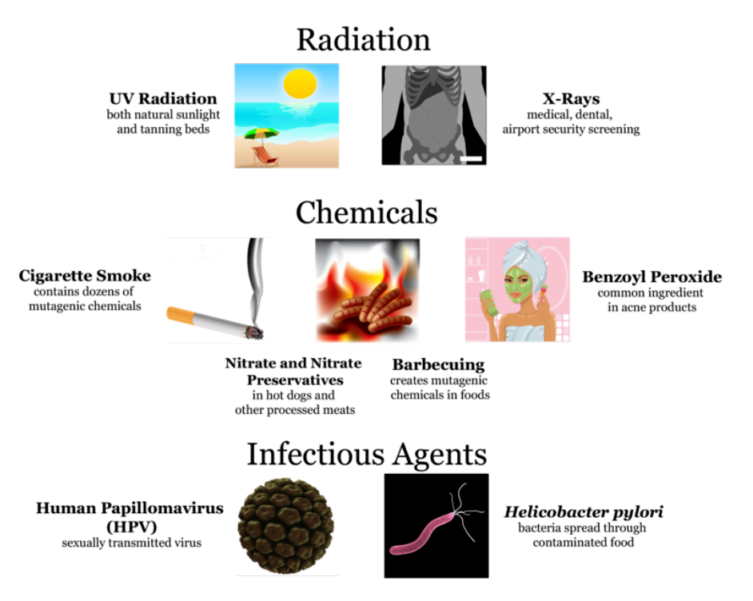
Categories of Mutation
Mutations can be caused by four main types of mutagens:
Physical agents – heat, mechanical damage, etc.
Chemical agents – pollutants, tobacco, food preservatives.
Radiation – UV light, X-rays, nuclear radiation.
Biological (infectious) agents – viruses, bacteria, parasites.

Slide 4
Physical Agents
Examples:
High temperature can break hydrogen bonds between DNA strands.
Mechanical stress from cell division errors can cause DNA strands to snap.
Asbestos builds up in the lungs and causes scarring, resulting in damage to DNA
How It Causes Damage:
Breaks or twists DNA double helix.
Can lead to deletions or chromosome rearrangements.
Protection:
Avoid overheating (e.g., tanning beds).
Keep cells healthy — proper hydration and rest aid DNA repair.

Slide 5
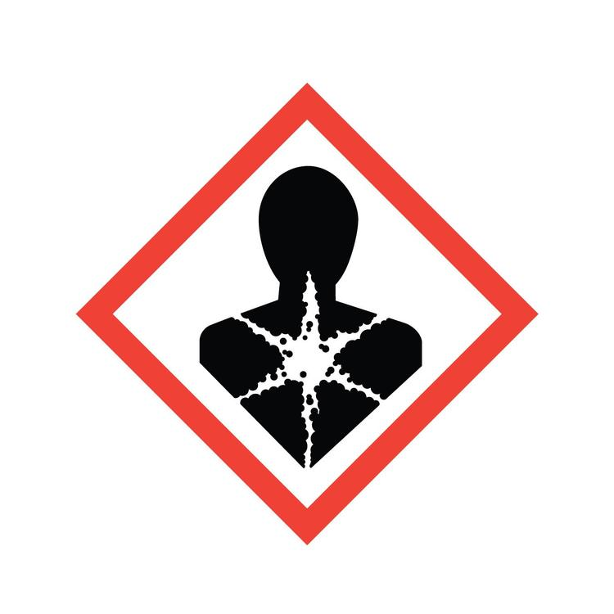
Chemical Agents
Examples:
Cigarette smoke (contains benzopyrene).
Processed foods (some preservatives, dyes).
Industrial pollutants and pesticides.
How It Causes Damage:
Chemicals can bind to DNA bases, making them pair incorrectly.
Causes substitution mutations during replication.
Protection:
Avoid tobacco smoke.
Limit exposure to harsh chemicals.
Wash fruits/vegetables and use gloves in labs.

Slide 6
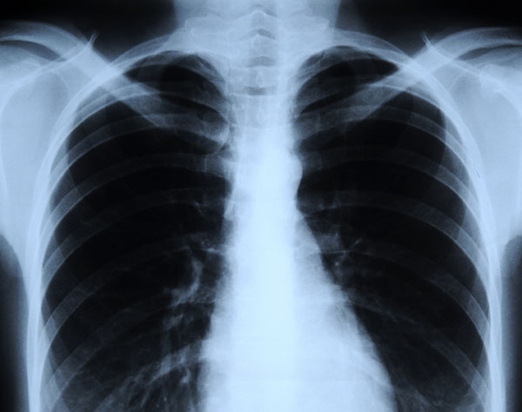
What to Expect:
Skin mutations → aging or skin cancer.
Cell death or uncontrolled growth (tumors).
Protection:
Wear sunscreen and protective clothing.
Limit exposure to X-rays and radiation sources.
Radiation
Examples:
Ultraviolet (UV) rays from the sun.
X-rays and gamma rays.
How It Causes Damage:
Creates thymine dimers (two thymines stick together).
Breaks DNA strands or changes base structures.

Slide 7
Infectious Agents
Examples:
Viruses like HPV, Hepatitis B/C, HIV.
Bacteria produce toxins that damage DNA.
How It Causes Damage:
Viruses insert their own DNA into host cells.
Can interrupt normal genes or activate cancer-causing genes.
Protection:
Vaccinations (HPV, Hepatitis B).
Safe hygiene and medical practices.

Slide 8
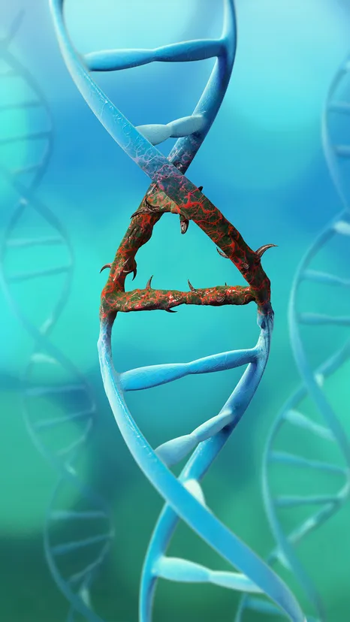
Spontaneous Mutations
What They Are:
Happen naturally when DNA replication errors occur.
DNA polymerase sometimes adds the wrong base or skips one.
How It’s Fixed:
Cells have repair enzymes that check DNA for mistakes.
When repair fails, the mutation becomes permanent.

Slide 9
Consequences of DNA Damage
Possible Outcomes:
No effect (neutral) – DNA repaired or mutation doesn’t change protein.
Harmful – disease, cancer, developmental disorders.
Beneficial – rare, but can lead to adaptation or evolution.
Example:
UV → skin cancer
HIV → immune cell mutation
Melanin increase → UV protection

Slide 10
Staying Safe
Healthy DNA Habits:
Wear sunscreen and protective clothing outdoors.
Don’t smoke; avoid chemical fumes and pollutants.
Eat antioxidant-rich foods (fruits, veggies).
Get vaccines for known viral mutagens (HPV, Hepatitis).
Practice lab safety: goggles, gloves, no direct contact with unknown chemicals.

