Slide 1
Mutation
The Mechanism for Evolution

Slide 2
Recall: DNA Structure
DNA is a double helix made of nucleotides
  These are called nitrogenous bases
    Adenine (A)
    Thymine (T)
    Cytosine (C)
    Guanine (G)
  These are paired up to make the double helix A with T, C with G

Slide 3
Protein Coding
Genes are coded in groups of 3, called codons (ex: AUG)
  These code for specific amino acids depending on their sequence
  These only use one half of the DNA called mRNA
    At this point, T becomes U (Uracil)
The sequence of these codons determines the shape and function of a protein

Slide 4
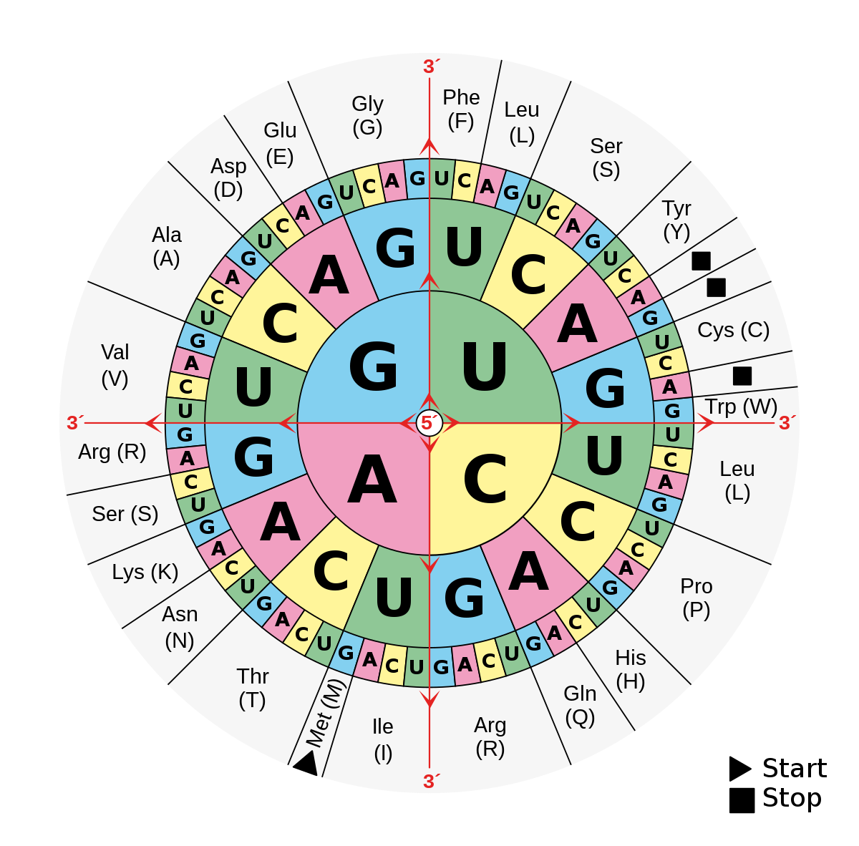
Amino Acids
There are 20 total amino acids, these combine in different ways to form different proteins
  The order of these matter, proteins will not work or have a different function if this is changed (so if this changes: MUTATION)
These proteins are the fundamental building blocks of all life

Slide 5
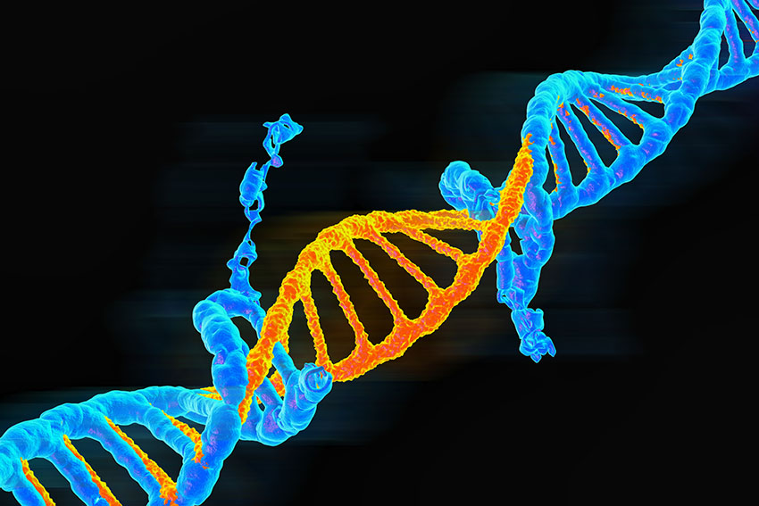
So what is mutation?
A mutation is a permanent change in the DNA sequence of a gene
  This can happen randomly during DNA replication or be caused by mutagens (think UV light)
  They can affect a single DNA base or large sections of a chromosome
These mutations can be passed onto offspring, leading to evolution

Slide 6
Types of Mutations

Slide 7
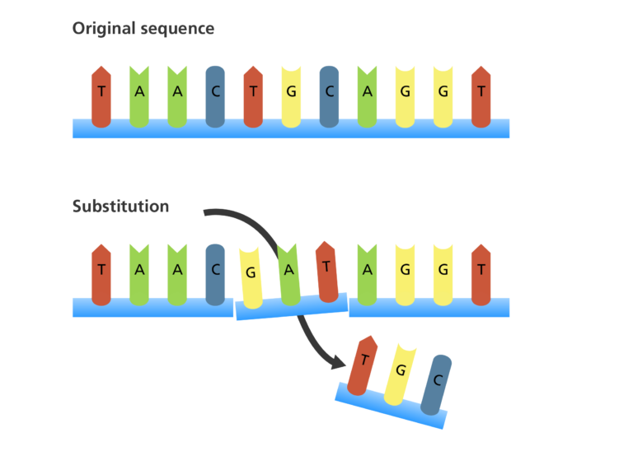
Substitutions
A substitution mutation replaces one base with another
  This can lead to different, or no proteins being produced by the sequence
  But is generally the least severe
Example:
AUG - ACG
  In this case, the U was substituted for C

Slide 8
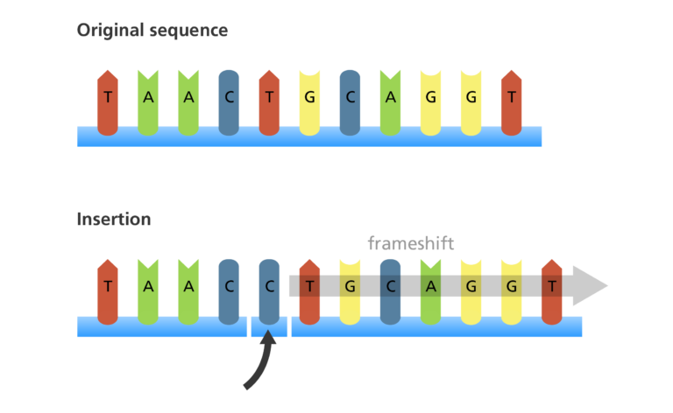
Insertion Mutations
An insertion adds one or more extra bases into the DNA sequence
  This can shift the reading frame if not in a multiple of 3
    This is called a frameshift
  This often results in a completely nonfunctional protein
Example:
AUG CGG - AAU GCG G
  Notice how the reading frame (groups of 3 gets shifted over), which would mess up other codons in the whole sequence

Slide 9
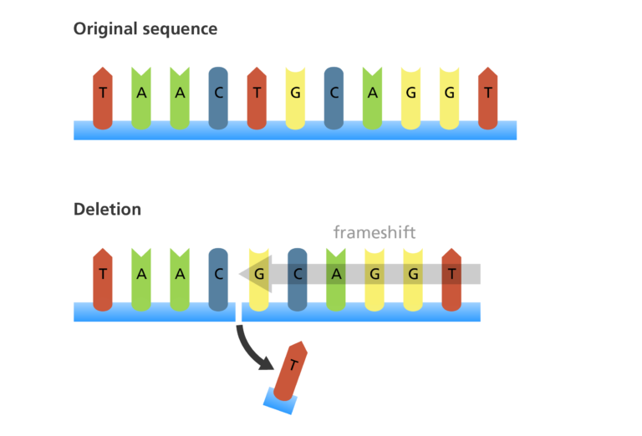
Deletion mutations
A deletion removes one or more bases from the DNA sequence
  If not in a multiple of 3, can also lead to frameshift mutations
Example: ATG CGG - AUC GG
In this case the G was deleted, therefore it would read differently and the GG would not read at all

Slide 10
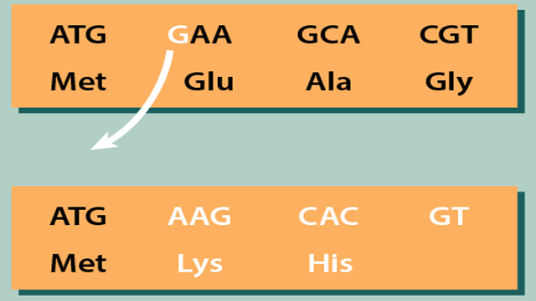
More on Frameshifts
Occur when insertions or deletions change the reading frame
  Since codons are read in sets of three, shifting the frame scrambles the entire message
  Typically this leads to a nonfunctional protein
These generally have a much more severe impact than substitutions and are more commonly the cause of genetic disorders

Slide 11
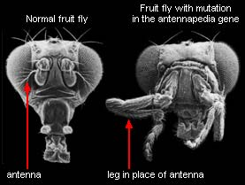
Effects of Mutations
Beneficial: sometimes a mutation can lead to a new trait that helps an organism adapt to its environment. This is one of the driving forces behind evolution
Harmful: Mutations can disrupt protein function and lead to diseases
Neutral: Many mutations don’t actually change the protein too much, enough that they really don’t matter

