Slide 1
From DNA to Life
Codons and Proteins

Slide 2
Recall: DNA Structure
DNA carries information in the form of nucleotides.
A always pairs with T, and C always pairs with G, forming the genetic code.
Genes are specific sections of DNA that code for particular traits.

Slide 3
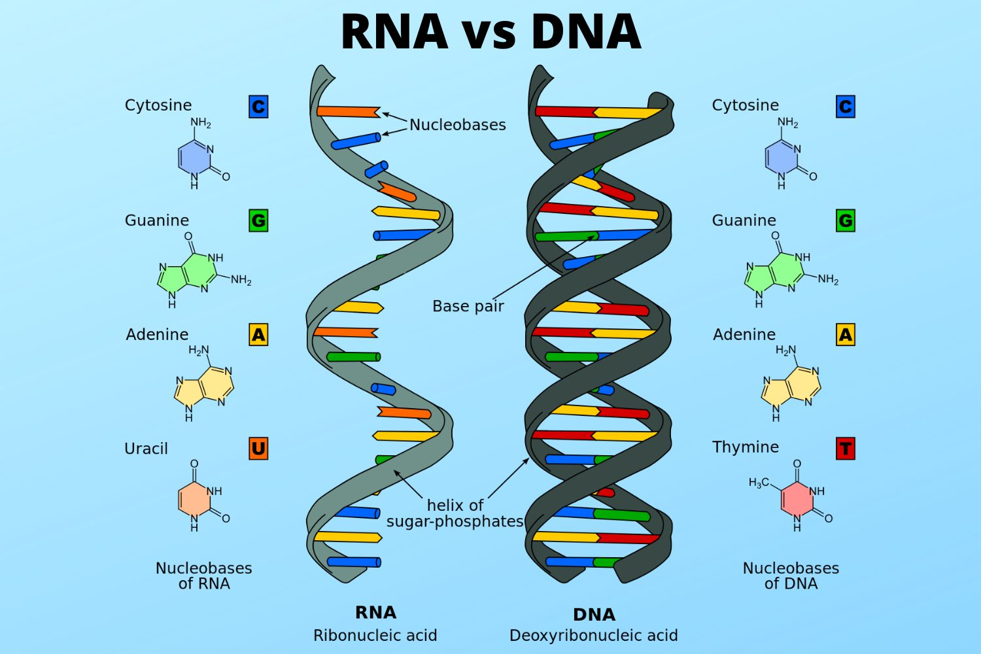
From DNA to RNA
To use the information stored in DNA, cells make a copy in the form of RNA.
RNA is similar to DNA but uses the base uracil (U) instead of thymine (T) and has only one strand.
This messenger RNA (mRNA) carries genetic instructions from the nucleus to the ribosome.

Slide 5
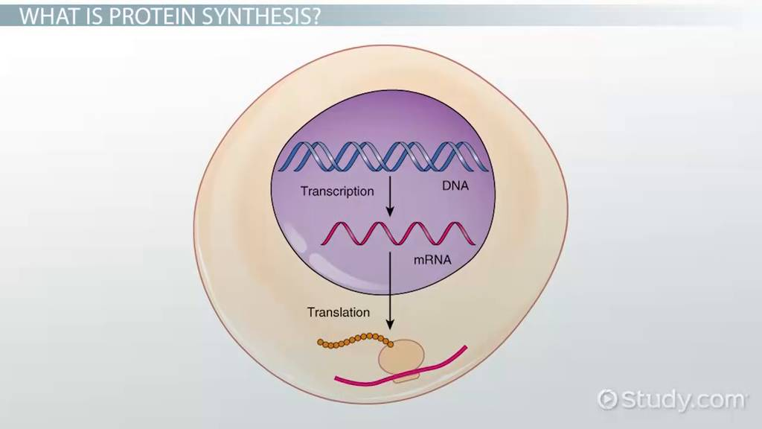
The Role of RNA in the Cell
mRNA acts like a recipe that tells the cell how to build a protein.
Ribosomes read the mRNA sequence and link together amino acids in the correct order.
Through this system, RNA acts as the link between DNA and protein

Slide 6
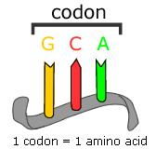
The Genetic Code
The mRNA message is read in groups of three bases called codons.
Each codon represents one specific amino acid, such as AUG for methionine (the start signal).
There are 64 possible codons that together code for 20 amino acids.
This universal code is shared by nearly all living organisms.

Slide 7
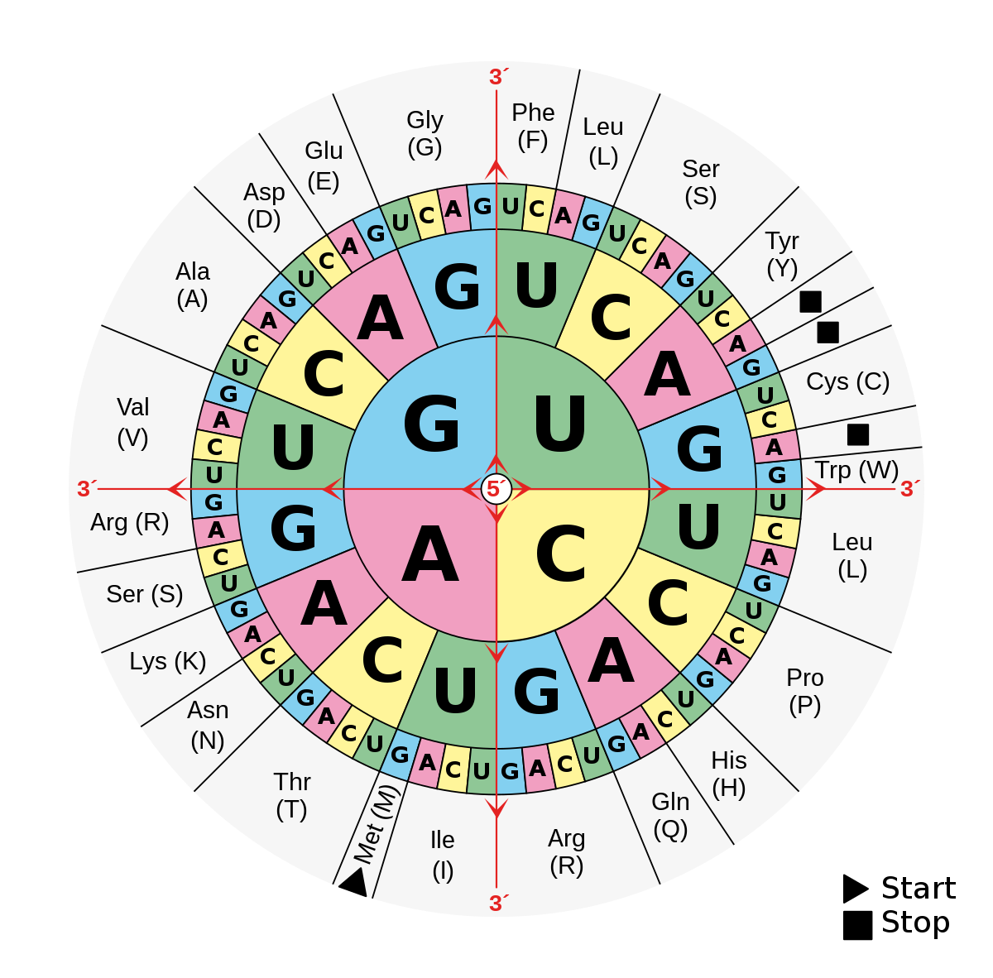
From Codons to Amino Acids
The amino acids are joined together by peptide bonds to form a growing chain.
This chain of amino acids is called a polypeptide.
Once complete, the polypeptide folds into a functional protein.

Slide 8
The Structure and Function of Proteins
The unique sequence of amino acids determines how a protein folds and what it does.
Some proteins are structural, giving cells shape and support.
Others are enzymes that speed up chemical reactions or hormones that send signals.
Every protein’s shape and function come directly from its DNA instructions.

Slide 9
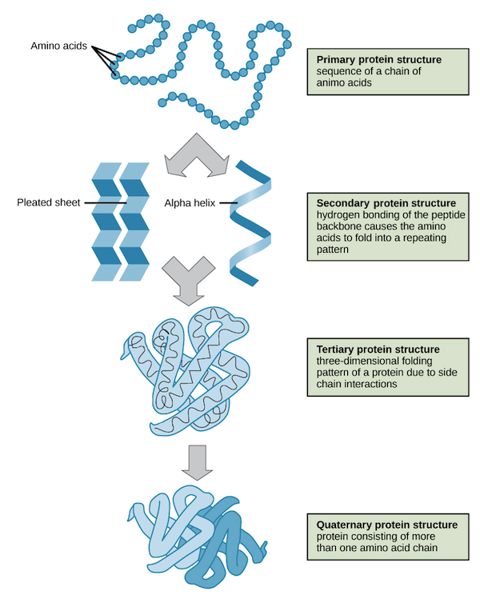

Slide 10
How DNA Controls Traits
DNA determines traits by deciding which proteins are made in each cell.
For example, the gene for melanin produces a protein that affects skin and hair colour.
Changes in DNA can lead to different versions of proteins and therefore different traits.
This shows how our genetic code directly influences our appearance and biology.

Slide 11
A Complete Overview
The pathway can be summarized as DNA → mRNA → Protein → Trait.
DNA holds the original code, mRNA copies it, and ribosomes use it to build proteins.
Those proteins create the physical and chemical traits of the organism.
This flow of information is known as the Central Dogma of Biology

Slide 12
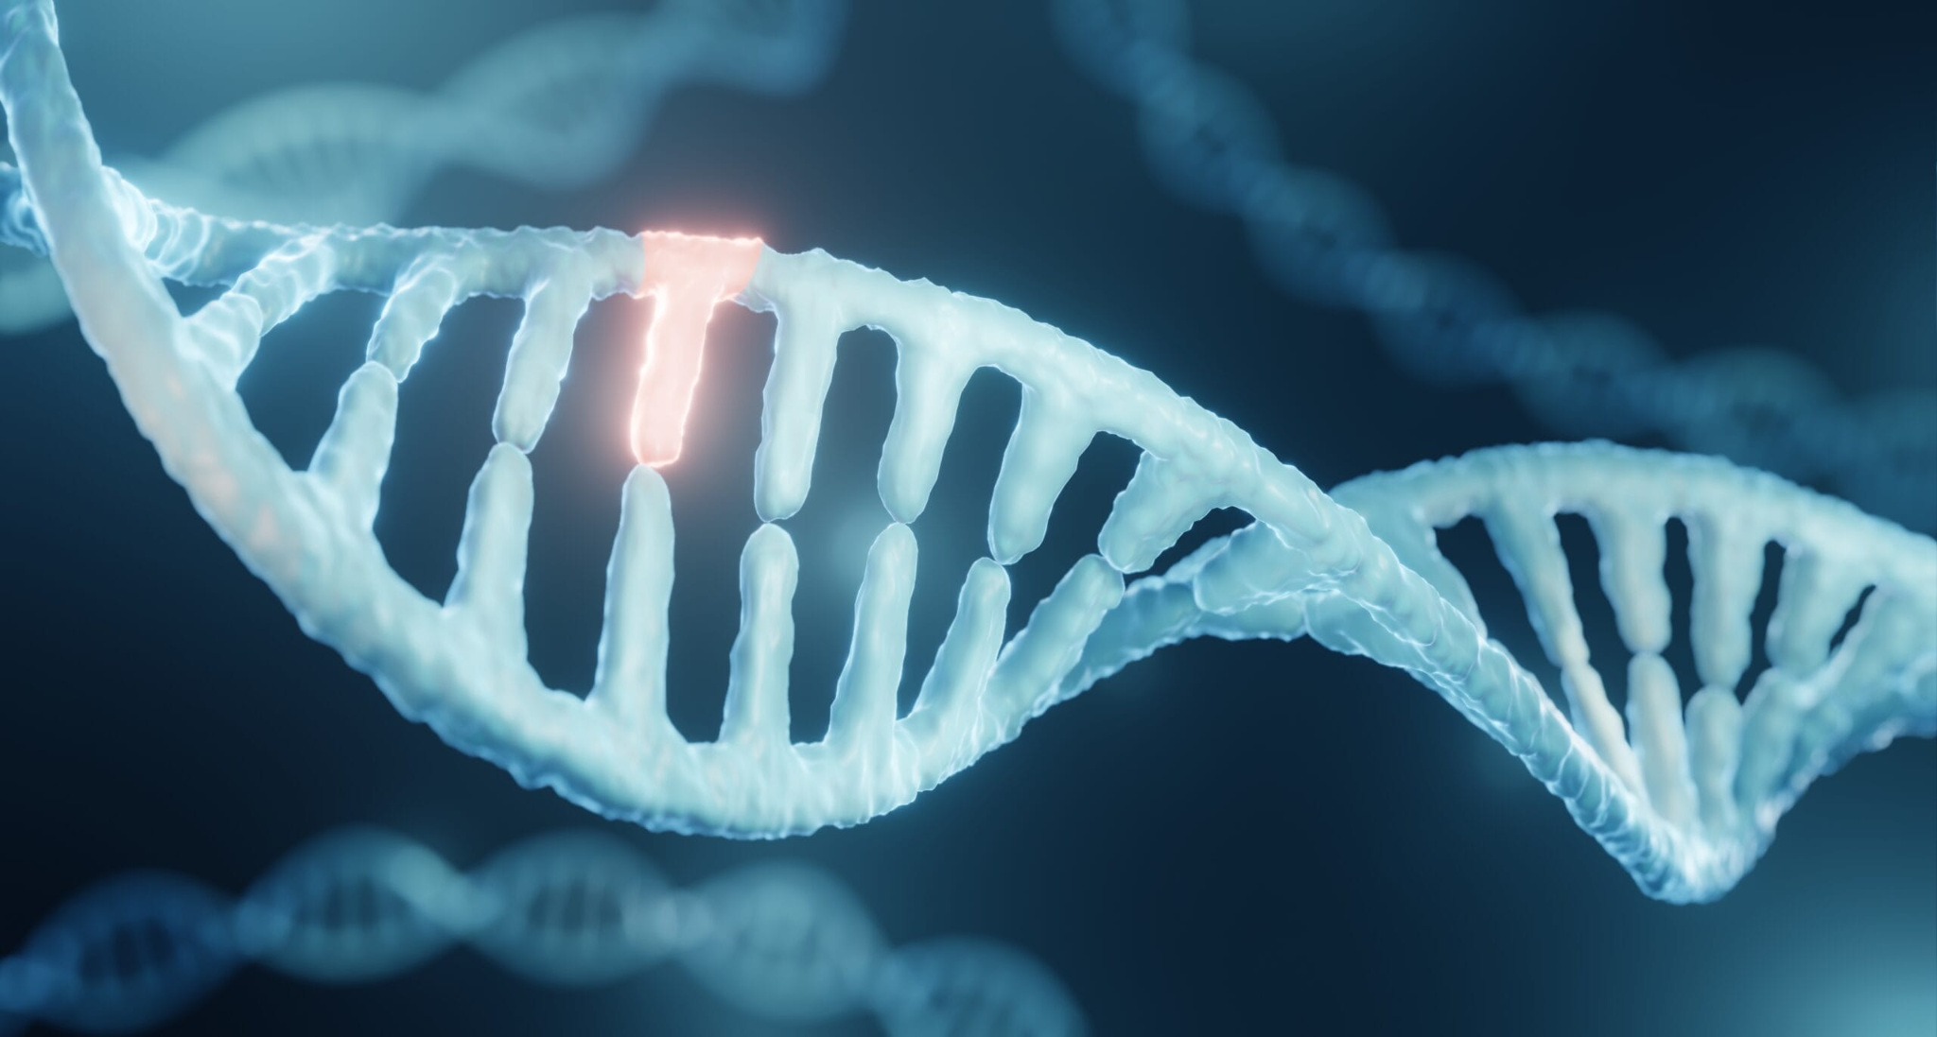
When Things Go Wrong
Sometimes errors occur when DNA is copied or transcribed into RNA.
These errors can change one or more bases in the genetic code.
Even a single change may lead to a different amino acid being added to a protein.
This kind of change is called a mutation.

