Slide 1
Inheritance and Genetics
How and Why do traits get passed on

Slide 2
What is Inheritance?
Inheritance is the process through which traits are passed from parents to offspring.
Almost every living thing inherits a unique combination of characteristics that make it what it is.
Understanding inheritance helps us predict and explain why we look similar, but not identical, to our parents.

Slide 3
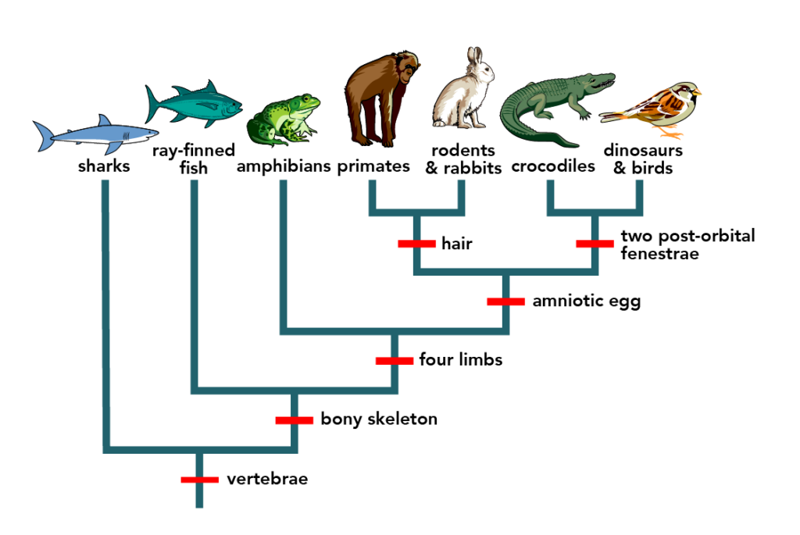
Why Study Inheritance?
Studying inheritance helps scientists and doctors understand diseases, evolution, and biodiversity.
It also helps us make informed choices about genetics, such as family health and conservation.

Slide 4
Genes and Alleles
A gene is a specific segment of DNA that carries instructions for one trait.
Different versions of that gene are called alleles.
For example, a gene for eye color may have one allele for brown eyes and another for blue.
Small DNA changes, mutations, can create new alleles, leading to diversity among organisms.

Slide 5
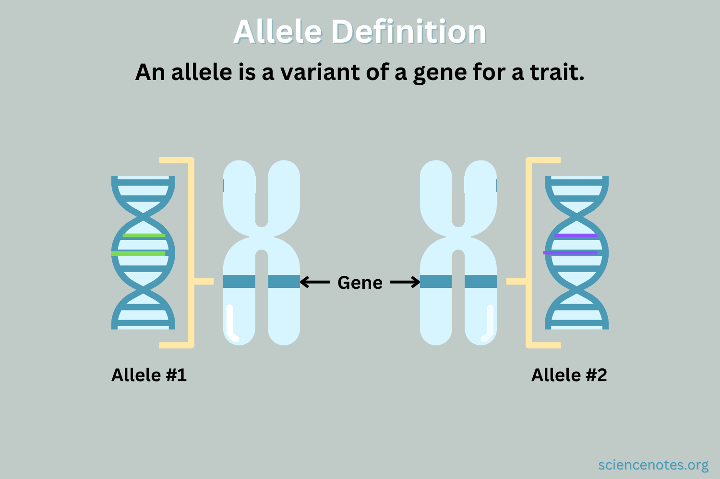
Connecting DNA to Alleles
Remember how DNA bases can change during mutation?
Those small base pair changes can create new alleles, slightly different versions of a gene.
  Think about different eye colours, those all came from mutations
These variations are what drive diversity and evolution in all species.

Slide 7
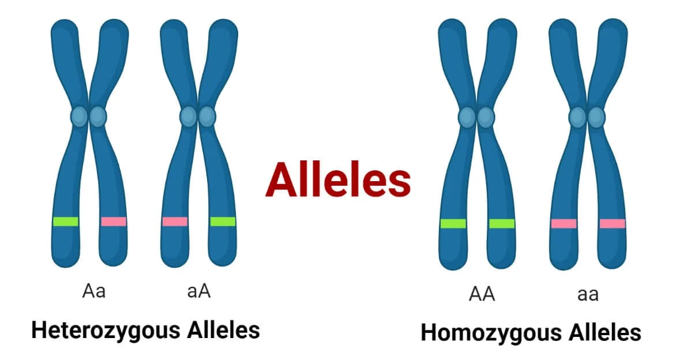
Chromosome Pairs
Each human cell (except sperm and egg) contains 46 chromosomes, 23 pairs.
You inherit one set of 23 from one parent and one set of 23 your other parent.
That’s why you carry two copies (alleles) of every gene, one from each parent.

Slide 8
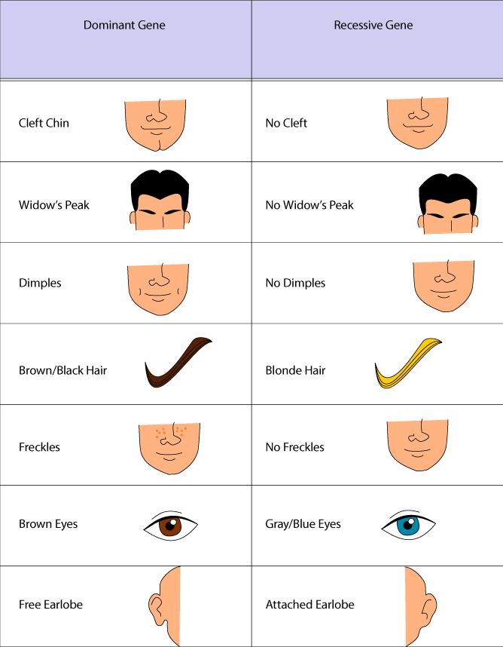
Dominant vs. Recessive Alleles
Sometimes, one allele can “mask” the effect of another.
A dominant allele is expressed even if only one copy is present.
A recessive allele only appears when both copies are the same.

Slide 9
Heterozygous vs. Homozygous
Because there are two possible alleles (being the dominant or recessive allele), and we have two copies, we are going to either have two different alleles, or two of the same
Having two of the same allele is called being homozygous
  So you could either be homozygous dominant or homozygous recessive
Having two different alleles is called is called being heterozygous

Slide 10
Phenotype vs. Genotype
Your genotype is your genetic code, the combination of alleles you have for a trait.
Your phenotype is how that trait appears physically, like having brown eyes or curly hair.
Two people can have the same phenotype but different genotypes depending on which alleles they carry.

Slide 11
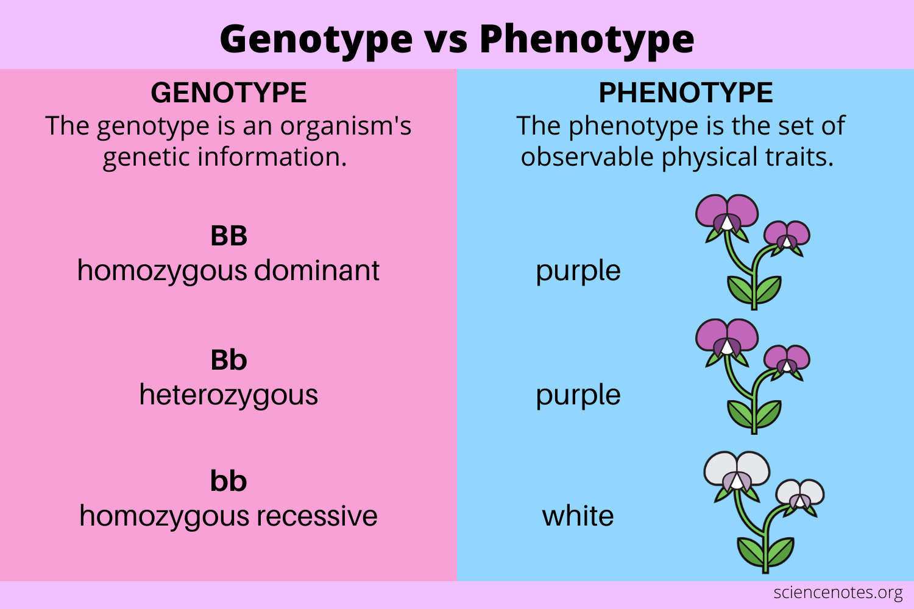
Phenotype vs. Genotype

Slide 12
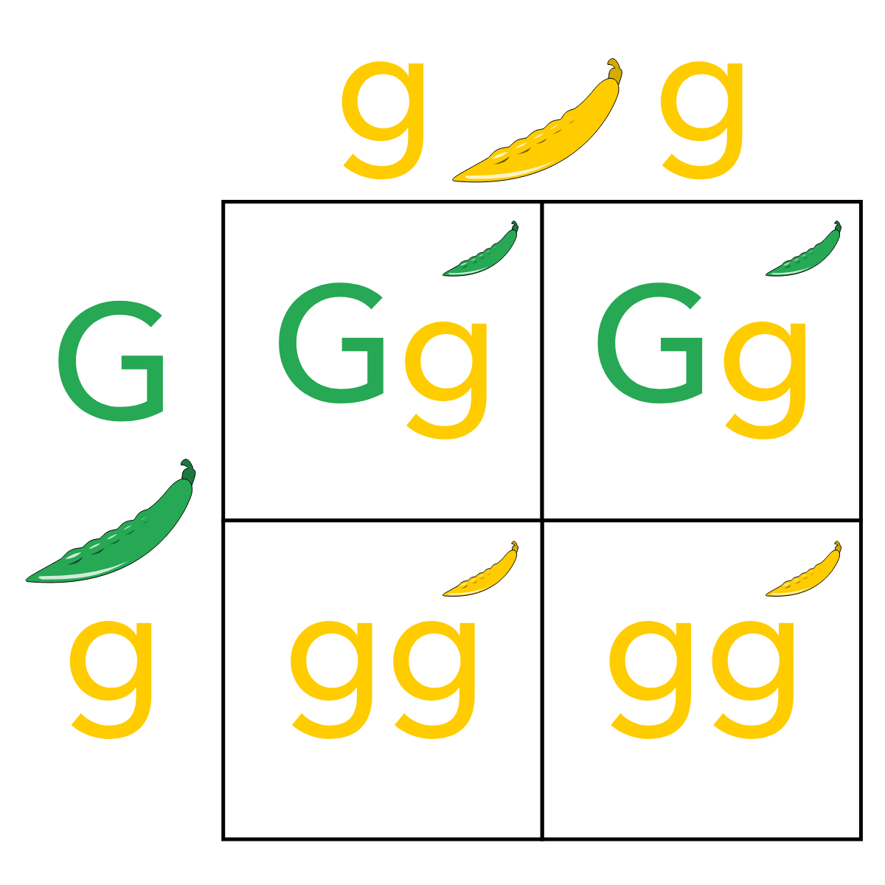
Punnett Squares
Punnett squares are tools that help predict the possible combinations of alleles in offspring.
Each box represents one possible outcome of a genetic cross.
Punnett squares can give us the percent chance of an offspring having one genotype or another.

