Slide 1
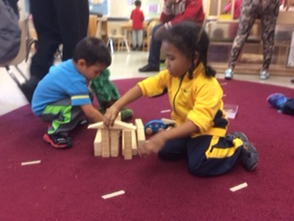
Block Play:
Joyful, Creative,
Constructive Learning!
Facilitated by Fiona Morrison
October 23rd 2020

Slide 2
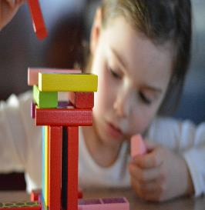
Shape of the Session
Welcome/Introductions
Playing together activity
Why Block play?
What do we know about the stages of Block play?
What learning happens during Block play?
What high quality resources are available?
How do I capture the learning?

Slide 3
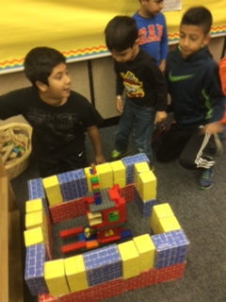
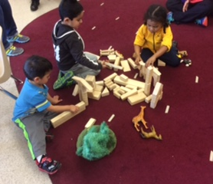
Playing Together

Slide 4
Playing together
In small groups talk and build:
What is currently happening with block play in your classroom?
What are the highlights?
What challenges do you have?
Notes:
Breakout room session 1

Slide 5
Why Block Play?
“Play is the highest expression of human development in childhood for it alone is the free expression of what is in a child’s soul.”
      Friedrich Froebel-father of Kindergarten and “Gifts”of blocks

Slide 6
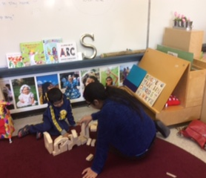
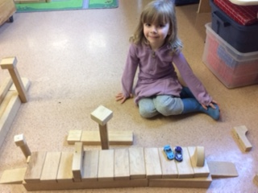
Block Play over time….
Notes:
Not only for pre K and K but for ALLL primary children

Slide 7
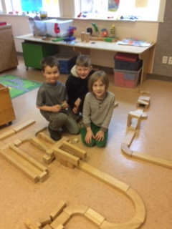
Playing with others
Notes:
K-3 example

Slide 8
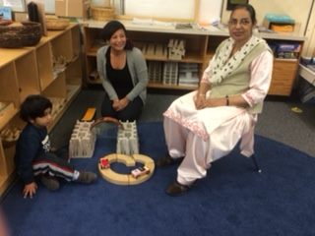
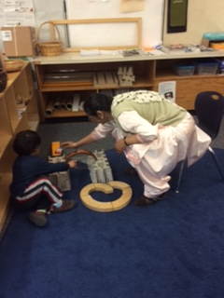
Playing with adults
Notes:
Role of the teacher/caregiver is important

Slide 9
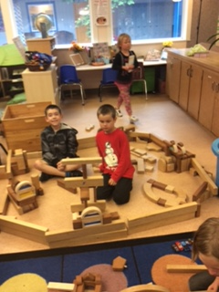
Collaboration

Slide 10
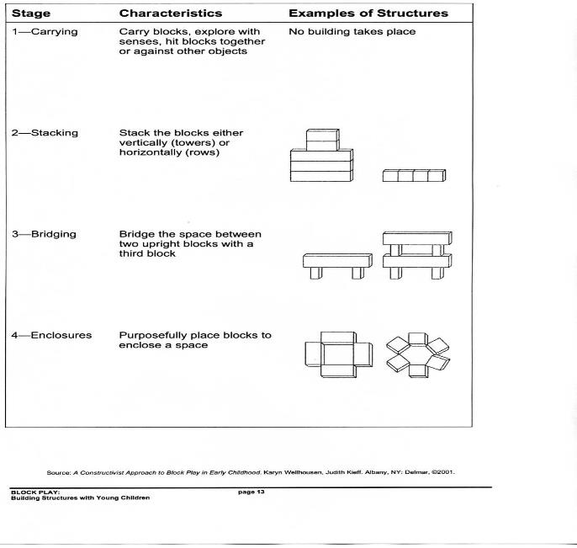
What do we know about block play from birth to age 8?

Slide 11
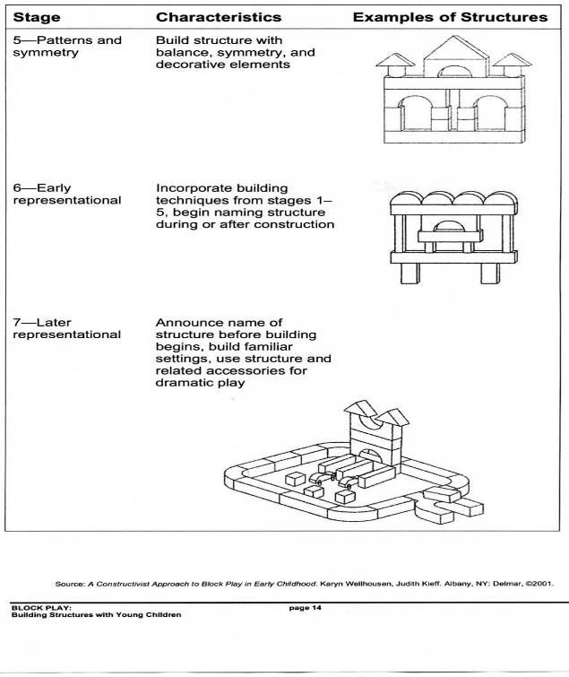

Slide 12
The Stages of Block Play
Stage One: Carrying Blocks
Stage one (Ages 2-3): In this stage, children carry, move, touch, hold, pile, knock down, drop, and feel the blocks. Children do little or no building. Instead, they explore the properties and characteristics of the blocks. Children answer the question, “What can I do with these?” At this stage, you can provide:
wagons for hauling
baskets for carrying
boxes in which to pile the blocks
suitcases (or backpacks or briefcases) in which to pack the blocks

Slide 13
The Stages of Block Play
Stage Two: Stacking Blocks
Stage Two (Age 3): In this stage, children stack blocks vertically, lay them down and line them up, or configure them horizontally. One block may be laid across another. Children will often repeat a pattern over and over. “Stack and Row” is a good name for this stage. Many times, you will observe children forming a combination of stacks and rows.
At this stage, you can provide:
 pattern cards, so the child can copy it with blocks
 cars and road signs
 floor mats on which to build
 a large piece of poster board, with a large triangle in the center, so she can build within the triangle

Slide 14
The Stages of Block Play
Stage Three: Bridging
Stage Three (Ages 3-4): This stage is known as bridging. It is the stage when children begin to make structures. Bridging is when children form a space between two blocks, and then place a block to span the space. Eventually, as the child masters and expands bridging, her bridges become more elaborate. Typically, the child will build in the stacks and rows she previously made and add the bridges. At this stage, you can provide:
 pictures of bridges
 architectural drawings that show bridging concepts
 a large piece of blue cloth (symbolizing water) and boats
 columns (typically used for elaborate cake decorating)

Slide 15
The Stages of Block Play
Stage Four: Enclosures
Stage Four (Age 4): This stage involves making enclosures. At this stage, children can close up space between blocks with another block(s). Children begin problem solving by planning ahead how they will close up spaces. After mastering enclosures by lying the blocks flat on the floor, children make an enclosure by standing the blocks on edge, and they may incorporate bridging. They discover and begin to understand the meaning of inside, outside, perimeter, and boundaries. They also observe balance and symmetry. Children add figures which take on imaginary roles as children play out social motifs that are meaningful to them. At this stage, you can provide:
 farm and zoo animals
 fruits and vegetables to make a fruit and vegetable stand
 a length of fabric or ribbon (to drape vertical enclosures)
 posters and photographs of buildings (especially those that show enclosures as elements of a structure)

Slide 16
Stages of Block Play
Stage 5 (age 4-5) patterns and symmetry
Builds Structures with balance , symmetry and decorative elements

Slide 17
The Stages of Block Play
Stages Six and Seven:
Early/Later Representational
Stages Six and Seven (Ages 5-6 and older): At this stage, children work cooperatively to build a structure, deciding in advance what they will build. They build their structures to look much like what they have planned in advance. Due to the complexity of the structure and the commitment of the children, they typically want to build and play with the structure over a period of several days. The children assign each other roles, and they use a variety of materials to achieve desired effects. At this stage, children excel at sorting, matching, classifying, and arranging patterns. They will also begin dramatic play around the block structure. At this stage, you can provide:
 A variety of hats and clothes  home building magazines
 measuring tools  blueprints
 small task cards  candles without wicks
 block building books  beanbag figures

Slide 18
Replay- Your Turn
In your small groups, use the materials to build a structure which is an example of one of the 7 stages. (Keep your stage private!)
As a whole group we will offer observations and ask questions of the builders using the following frame of See/Think/Wonder.
Each group will then share their process and stage that is represented.

Slide 19
What learning happens during block play?
Curriculum Connections
Core Competency Connections
Some examples……………………

Slide 20
Mathematics
space
shapes
size
order
Number
Fractions
weight
length
• depth
• width
• height
• mapping
• symmetry
• quantity
counting
patterns
equal/unequal
recognize sets or groups
shortest / longest
tallest / shortest
estimate
•similarities and differences
•classification
•planning
•measurement – volume, area
•graphing
•one-to-one correspondence
•part and whole relationships
Source: The Block Book Revised Edition: Hirsch, Elizabeth S.,: Washington D.C. : NAEYC 1984

Slide 21
Science
• gravity
• systems
• interaction
• planning
• diversity
• patterns
• problem-solving
• weight
• discovery
• force
• balance
• stability
• observation
• cause and effect
• inductive thinking
• experimentation
• interdependence
• properties of matter
• inclined plane
• creative thinking
Source: The Block Book Revised Edition: Hirsch, Elizabeth S.,: Washington D.C. : NAEYC 1984

Slide 22
Physical Development
SMALL MUSCLES
visual perception
finger control
eye-hand coordination
controlled hand manipulation
LARGE MUSCLES
sides of body working together
bending
moving through space
body awareness
squatting
balance
Source: The Block Book Revised Edition: Hirsch, Elizabeth S.,: Washington D.C. : NAEYC 1984

Slide 23
Social-Emotional
• initiative
• autonomy
• role play
• clean-up
• taking risks
• cooperation
• responsibility
• group behavior
• make choices
• self-confidence
• work with others
• feeling of competence
• respect for the work of others
Source: The Block Book Revised Edition: Hirsch, Elizabeth S.,: Washington D.C. : NAEYC 1984

Slide 24
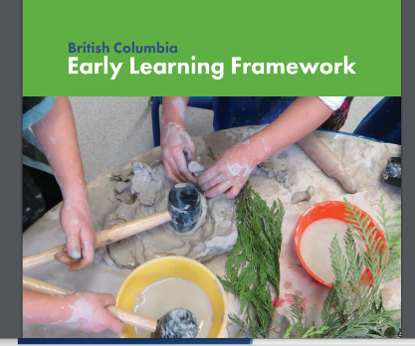
Connections to ELF
Engaging with Others, Materials and the World
Pathways:
Spaces Objects and Materials (page 77)
Time for Engagement
(Page 78)

Slide 25
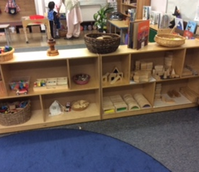
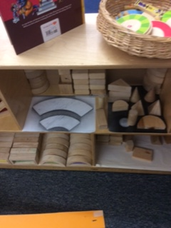
Organization and Storage
Notes:
This is often a sticking point-how do we manage organisation storage and clean up

Slide 26
Materials
Unit blocks
Hollow blocks
Cardboard,table blocks -Wintergreen, Louise Kool
Tree Blocks, Rainbow blocks – Natural Pod
Loose parts: rocks, shells, pinecones, all natural materials, glass beads
Cars and trucks
Woodland ,farm and other animals (Schleich)

Slide 27
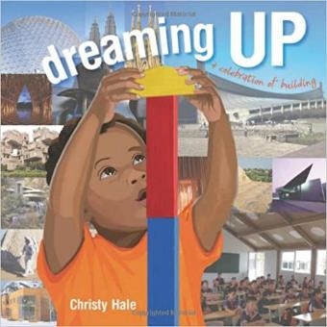
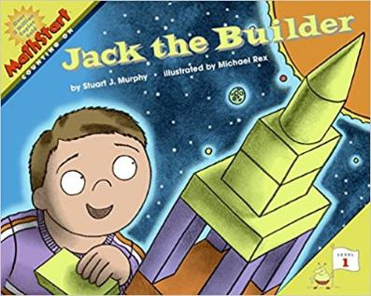
Literacy Links

Slide 28
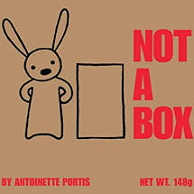
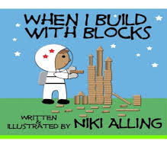
Literacy Links

Slide 29

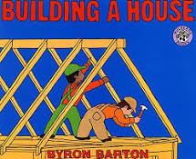
Literacy Links

Slide 30
Activities with picture books
Choose a book to play with in your small group
How could you use these in your classroom in connection with block play ?
What would you do?
Share in large group
Notes:
10 minutes in breakout room to share

Slide 31
How do I capture, document, celebrate and share learning?
Observe and document
Collect Traces
Take Photographs/share with children
Begin the process of Pedagogical Narration

Slide 32
What to look for at the Block Centre
Approximate ages 2 to 5
What does the child do with blocks?
□ reaches □ grasps □ lifts □ carries
□ shoves □ collects □ arranges □ sorts
□ orders □ make patterns □ balances
How is balance achieved?
□ adds on □ adding and removing
What kind of block structure does child make?
□ vertical rows □ horizontal rows □ bridges □ arches □ enclosures
Are block structures named?
□ rarely □ before □ during □ after construction
How does child use block structure after it is completed?
What is the most preferred type of block used by the child?
□ light □ heavy □ large □ small
Can the child use language to extend ideas to others in playgroup?

Slide 33
What to look for at the Block Centre
Approximate ages 5 to 7
What does the child do with blocks?
Which type of blocks does child prefer to use most often? □ cardboard □ table blocks
□ uni block □ hardwood blocks
Does the child…
□ sort □ orders □ make patterns □ balances □ build walls □ name constructions
□ makes comparisons and sees relationships
How is balance achieved? Does child add and take away blocks from each side?
Does child select blocks with awareness of size, pattern, symmetry?
What kind of block structures does child make?
□ houses □ trucks □ spaceships □ theme related structures
How does the child use the structure after it is completed?
How does the child record what has been constructed?
□ uses pictures □ maps □ a plan □ uses descriptive language
How is language developing? Can child instruct, use new vocabulary, build on existing idea, successfully incorporate the ideas of playmates?
Is child developing and using mathematical and scientific concepts?
E.g., making patterns-teachers makes block pattern and child can continue the sequence, teacher makes and child can build and sequence.

Slide 34
Viewing with a purpose/Closure
View YouTube video; Standard Unit Blocks Large
Observe the examples of stages of block play
Think about what you are taking back to your program
Notes:
Insert link into this slide

Slide 35
Print Resources
Chalufour, Ingrid and Karen Worth (2004). Building structures with young children. St. Paul,
Minnesota: Redleaf Press.
Hirsch, Elisabeth S., Ed. (1984). The Block Book. Revised Edition.
Washington, DC: National Association for the Education of Young
Children.
MacDonald, Sharon (2001). Block Play: The Complete Guide to Learning and Playing with Blocks. Beltsville Md: Gryphon House, Inc.
Wellhousen, Karyn, Judith Kieff (2001). A Constructivist Approach to Block Play in Early Childhood. Albany, NY: Delmar.

Slide 36
Internet Resources
www.pbs.org/wgbh/buildingbig (for older children- information on bridges etc.)
www.learningmaterialswork.com
www.drdrewsblocks.com
www.sharonmacdonald.com/block-play
www.communityplaythings.co.uk/c/Blocks/UnitBlocks/index.htm
-video on Foundations:Building STEM skills
cela.albany.edu/literacycorner/activities/Blocks.htm
homeschool.lifetips.com/tip/31730/powerful-play/powerful-play-general/index.html
www.drdrewsblocks.com
Notes:
Just a few resources

Slide 37

Closing Circle
In chat please:
Share one key idea you are taking back to your context

